Slide 1

جامعة المنوفية
كلية الحاسبات والمعلومات
2021-2022
MENOUFIA UNIVERSITY
SYSTEM ANALYSIS & DESIGN PROJECT
SECOND YEAR
2021-2022
No. | Name | Section
1 | سامح طارق محمد محمود غنيم | 8
2 | زياد عبدالمنعم جابر أبو عجيزة | 8
3 | زياد ناصف زهران مبروك | 8
4 | سلمي أحمد عبد الشهيد محمد | 8
5
6

Slide 2
Project Identification
Project Name:
Souq.com system Current Problem:
There is a big need to provide an E-commerce system in the middle-east as there is much
Product that customer can’t find and don’t know how to get it.
So we plan to create an E-commerce system for souq company that will make it easy
to reach the product you look for and easy way to deliver it to the customer. Description about project:
we aim to make it easy to purchase online, make it easy to find product you look for and have an efficient way to deliver the product in short
time so we should provide :
1-Efficient drivers to deliver the products
2- web page that provide reservation and purchase online
3- help center to help the client if he has a problem
4-Provide many outlets for sale in the country
Planning

Slide 3
System Request— (souq.com)
Project Sponsor: | Ziad nasef
Business Need: | The project aim to create an E-commerce system for a souq company in Egypt that make it easy to organize products and provide reserve and purchase online and so sell product as many as we can
Business Requirements: | we aim to make it easy to purchase online, make it easy to find product you look for and have an efficient way to deliver the product in short time so we should provide : 1-Efficient drivers to deliver the products 2- web page that provide reservation and purchase online 3- help center to help the client if he has a problem 4-Provide many outlets for sale in the country
Business Value: | The system will help to increase the sales with a high percentage by providing efficient and organized way to find the product and purchase it and show recommended products and offers that customer may like without face difficulties to find the product you want. So we expect a high revenue. Conservative estimates of tangible value to the company include the following 30000$ : for reversing and purchase online 10000$ : for offers days 4000$ : for deliver the products
Special Issues or Constraints: | 1- The market is competitive and there is big companies has a large customer base like (jumia-b.tech -etc) 2-The page will be vulnerable to spam emails

Slide 4
Feasibility study
Technical feasibility:
The souq company system is feasible technically, although there is some risks as.
→There is a little workers in IT department who has enough experience to build online market system, but the company are hiring an efficient engineers that will help.
→Online payment methods should be improved (under development)
- Source’s risk regarding familiarity with the technology is moderately high.
→ IT department has old and weak devices and technologies (should be changed)
→The online market is new idea for our developer so they need an experienced team lead.
- The project size is considered medium risk.
→The project team will consist of 12 or fewer people
→The ISP should improve its services to accommodate the online market.

Slide 5
Economic feasibility:
-A cost-benefit analysis was performed and there are indications that there will be a good financial and moral gains.
-so the online market will be a good chance of significantly enhancing the company bottom line.
→RoI over 3 years : 300%
→NPV over 3 years :5,018, 522$
→Break-even occurs after 0.75 years
- Intangible Costs and Benefits:
→improve customer satisfaction and enhancing company reputation

Slide 6
: Organization Feasibility
-From an organizational perspective, this project has low risk, and the managers are experienced and have a good knowledge about the project.
→Customers will have the chance to buy products when they at home with suitable price.
→The project will cover many products and outlet so have advantages over the competitors
-Addition comments
→we should hire a consultant with expertise in similar application to assist with the project

Slide 7
Planning
(Parallel Method)
Analysis
Design
Implementation
Design
Design
Implementation
Implementation
Design
Implementation
We chose this method to reduces the time required to deliver a system
by parallel Design and Implementation phases.

Slide 8
Time Estimation
 | Planning | Analysis | Design | Implementation
Standard percentages | 15% | 20% | 35% | 30%
Estimated time based on planning time | Actual: 9 days | Estimated: 12 days | Estimated: 21 days | Estimated: 18 days

Slide 9
Tasks Identification
Name of Task | System Request (A)
Start Date | 2-11-2021
End Date | 3-11-2021
Person assigned to task | Ziad Nasef
Priority | High
Resources Needed | Microsoft PowerPoint Google
Estimated Time | 5 Hours
Actual Time | 4 Hours
Name of Task | Feasibility Study(B)
Start Date | 3-11-2021
End Date | 6-11-2021
Person assigned to task | ziad nasef
Priority | Medium
Resources Needed | Microsoft PowerPoint Google
Estimated Time | 15 Hours
Actual Time | 20Hours

Slide 10
Name of Task | Time Estimation (C)
Start Date | 7-11-2021
End Date | 8-11-2021
Person assigned to task | Salma
Priority | Low
Resources Needed | Microsoft PowerPoint
Estimated Time | 2 Hours
Actual Time | 3 Hours
Name of Task | Task Identification (D)
Start Date | 7-11-2021
End Date | 10-11-2021
Person assigned to task | Salma
Priority | Medium
Resources Needed | Microsoft PowerPoint
Estimated Time | 9 Hours
Actual Time | 10 Hours

Slide 11
Name of Task | Interview (E)
Start Date | 15-11-2021
End Date | 16-11-2021
Person assigned to task | Sameh
Priority | medium
Resources Needed | Microsoft PowerPoint
Estimated Time | 6 Hours
Actual Time | 6 Hours
Name of Task | Questionnaire (F)
Start Date | 16-11-2021
End Date | 17-11-2021
Person assigned to task | Zeyad nasef
Priority | Medium
Resources Needed | Google
Estimated Time | 4 Hours
Actual Time | 5 Hours

Slide 12
Name of Task | Data Flow Diagram (G)
Start Date | 15-11-2021
End Date | 17-11-2021
Person assigned to task | Salma
Priority | High
Resources Needed | Microsoft PowerPoint
Estimated Time | 6 Hours
Actual Time | 8 Hours
Name of Task | Data Dictionary (H)
Start Date | 28-12-2021
End Date | 30-12-2021
Person assigned to task | Zeyad Aboageza
Priority | Meduim
Resources Needed | Microsoft PowerPoint
Estimated Time | 10 Hours
Actual Time | 15 Hours

Slide 13
Name of Task | Process Specification (I)
Start Date | 28-12-2021
End Date | 30-12-2021
Person assigned to task | Zeyad nasef
Priority | high
Resources Needed | Microsoft PowerPoint
Estimated Time | 9 Hours
Actual Time | 10 Hours
Name of Task | Entity Relationship (J)
Start Date | 1-12-2021
End Date | 3-12-2021
Person assigned to task | Salma
Priority | high
Resources Needed | Microsoft PowerPoint
Estimated Time | 5 Hours
Actual Time | 8 Hours

Slide 14
Name of Task | Normalization (K)
Start Date | 3-12-2021
End Date | 4-12-2021
Person assigned to task | Salma
Priority | high
Resources Needed | Microsoft PowerPoint
Estimated Time | 5 Hours
Actual Time | 7 Hours

Slide 15
Task ID | Task Name | Assigned to | Estimated |  |  | Actual |  |  | Dependency | Status
 |  |  | Duration (Hours) | Start Date | Finish Date | Duration(Hours) | Start Date | Finish Date
A | System Request | Ziad Nasef | 5 | 2-11-2021 | 3-11-2021 | 4 | 2-11-2021 | 3-11-2021 | - | Open
B | Feasibility Study | Ziad Nasef | 15 | 3-11-2021 | 6-11-2021 | 20 | 3-11-2021 | 6-11-2021 | - | Open
C | Time Estimation | Salma | 2 | 7-11-2021 | 8-11-2021 | 3 | 7-11-2021 | 8-11-2021 | A ,B | Open
D | Task Identification | Salma | 9 | 7-11-2021 | 10-11-2021 | 10 | 7-11-2021 | 10-11-2021 | C | Open
E | Interview | Sameh | 6 | 15-11-2021 | 16-11-2021 | 6 | 15-11-2021 | 16-11-2021 | A | Open
F | Questionnaire | Ziad Nasef | 4 | 16-11-2021 | 17-11-2021 | 5 | 16-11-2021 | 17-11-2021 | E | Open
G | Data Flow Diagram | Salma | 6 | 15-11-2021 | 17-11-2021 | 8 | 15-11-2021 | 17-11-2021 | F | Open
H | Data Dictionary | Zeyad Aboageza | 10 | 28-12-2021 | 30-12-2021 | 15 | 28-12-2021 | 30-12-2021 | G | Open
I | Process Specification | Ziad Nasef | 9 | 28-12-2021 | 30-12-2021 | 10 | 28-12-2021 | 30-12-2021 | G | Open
J | Entity Relationship | Salma | 5 | 1-12-2021 | 3-12-2021 | 8 | 1-12-2021 | 3-12-2021 | G | Open
K | Normalization | Salma | 5 | 3-12-2021 | 4-12-2021 | 7 | 3-12-2021 | 4-12-2021 | J | Open

Slide 16
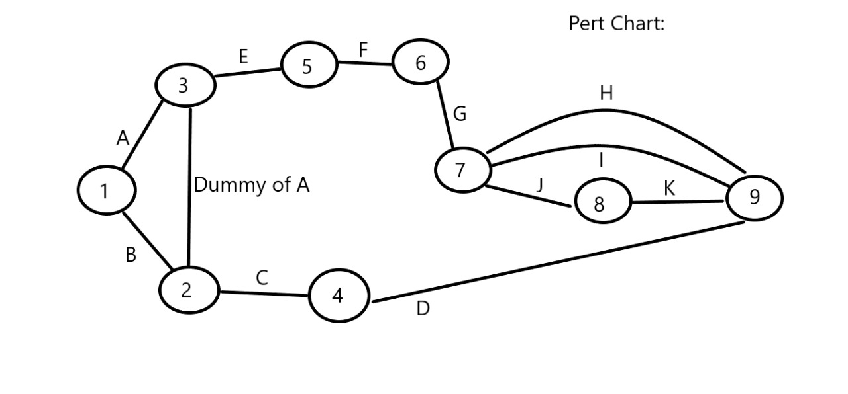

Slide 17
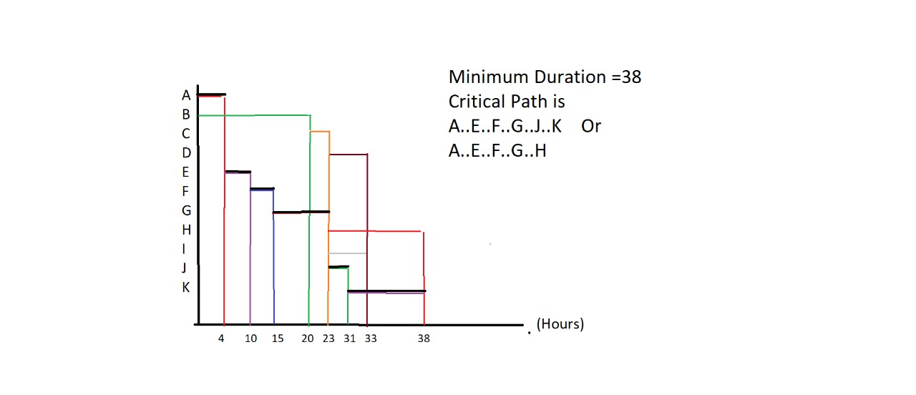

Slide 18
Interview :

Slide 19
1- What do you think of the current state of your system?
-It's not good enough.
2- What are the common errors in your current system?
-Not having enough information about each product within the online store.
-Difficulty of requests .
-The website is not optimized internally for search engines.
-Absence of related products.
-Do not display home policy.
-Not paying attention to a simple and convenient website design.
-Ease of obtaining orders.
3- What do you want in your new system?
-Using powerful hosts that provide much better layers of protection than shared hosting.
-Establish clear usage and privacy policies.
-Set clear rules of how to deal and explain how to protect user rights.
-Contact information must be included, such as a phone number, e-mail, and land address
-It is also preferable to establish a special section for technical support to respond to visitors' inquiries.
-It is preferable to make the online store to display products only, while the payment methods are external, such as dependent
On paypal in the purchase process or other popular sites, buyers use such safe means
In paying it makes them make the purchase with more confidence.
– Use https instead of http .

Slide 20
4- How do you feel about the next year in your system?
- It will be good from the previous system, and it will become popular with users.
Profit will increase.
5- What is the most valuable source of information for you?
-Primary sources allow researchers to get as close as possible to original ideas.
-Secondary sources analyze, review, or summarize information in primary or other secondary sources.
Higher education resources provide overviews of topics by compiling information collected from other sources.
-Third-order resources often provide data in an appropriate form or provide information with a context in which to interpret it.
6- What are the critical goals of your company?
- Reaching a prestigious position among other companies.
-High profit.
- To be the best company in the Arab world.
7- What technologies are you using now in your current system?
- Only one website page.
- Low security system.

Slide 21
8- What technologies do you want to include in the new system?
- Mobile app design for easy access.
- Get new website pages for easy access for users.
- Phone answering system.
- Special services for people with special needs.
- Cash register, credit card collection and check processing.
9. Do you have anything else to add?
-no thanks.
10- I think that it will be a wonderful system and I wish you all the best and success, God willing, in what is to come.
11- Who should I talk to next?
-Company Director.
12- When will I meet him, God willing?
- In two weeks, God willing.
Thank you for your time and let me shake hands with you and good luck, God willing.

Slide 22
Interview Report
Person Interviewed: Ahmed , He works at Souq.com company . Interviewer: Sameh Tarek. Purpose of Interview: -1Knowing the problems of the current system in the online market. -2New system requirements. Summary of Interview: *At first he told me the system wasn't good enough and then he told me his problems were: -Not having enough information about each product within the online store. - Difficulty of requests -The website is not optimized internally for search engines. -Absence of related products. -Do not display home policy. -Not paying attention to a simple and convenient website design. -Ease of obtaining orders. *Then he told me about the technologies he wanted in his new system, which is: -Using powerful hosts that provide much better layers of protection than shared hosting. -Establish clear usage and privacy policies. -Set clear rules of how to deal and explain how to protect user rights. -Contact information must be included, such as a phone number, e-mail, and land address -It is also preferable to establish a special section for technical support to respond to visitors' inquiries. -It is preferable to make the online store to display products only, while the payment methods are external, such as dependent On paypal in the purchase process or other popular sites, buyers use such safe means In paying it makes them make the purchase with more confidence. – Use https instead of http . And tell me what technology he wants: - Mobile app design for easy access- Get new website pages for easy access for users. -Phone answering system. - Special services for people with special needs- Cash register, credit card collection and check processing. ***And in the end I knew from him who I would meet next time and when. Then I shook hands with him and wished him success and excellence.

Slide 23
Questionnaire :

Slide 24
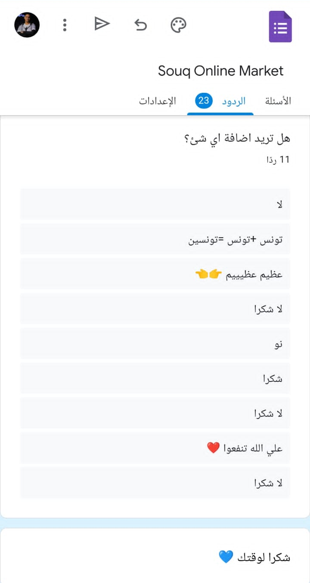
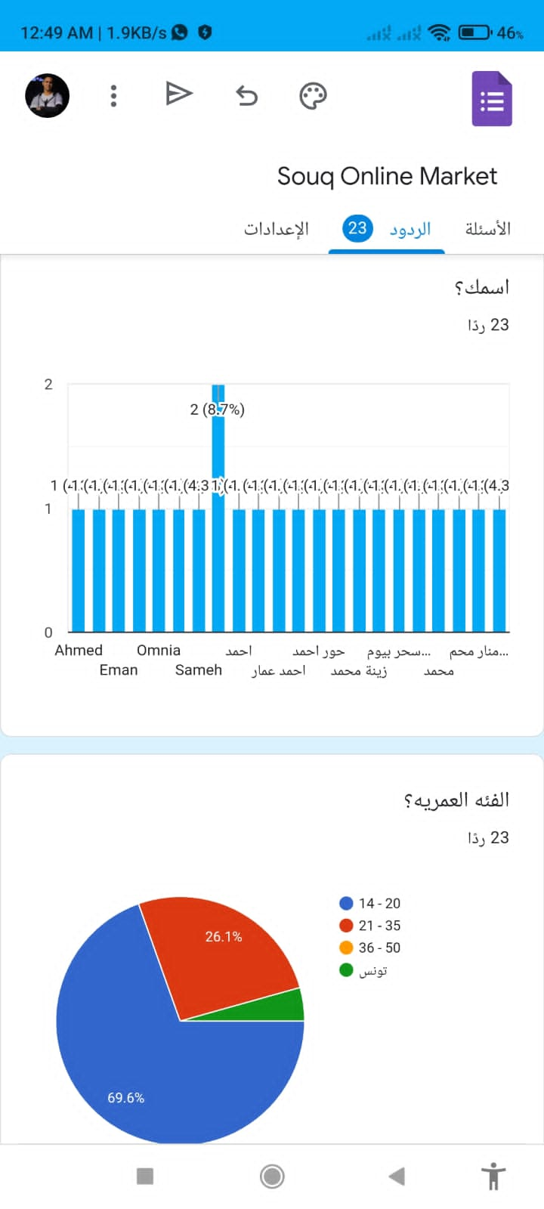
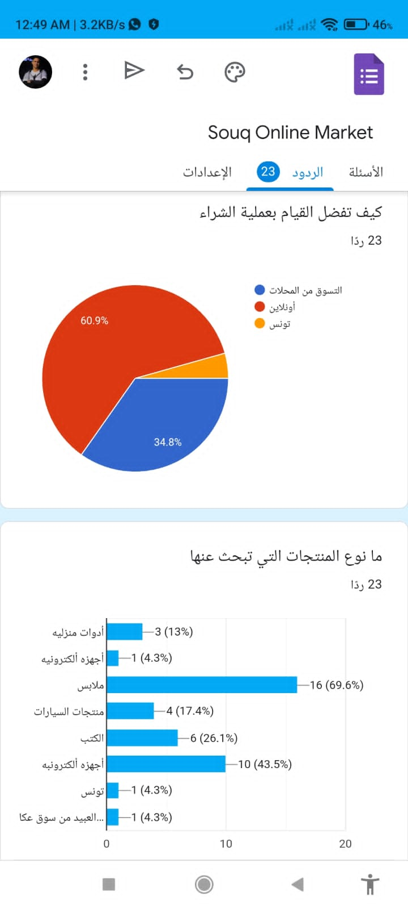

Slide 25
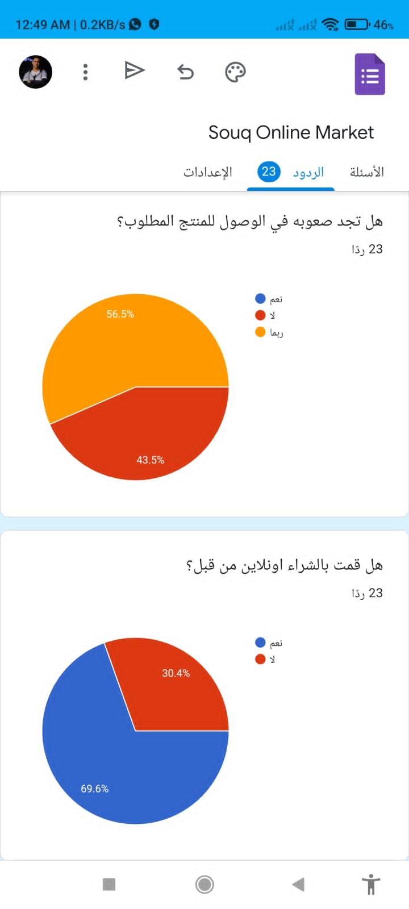
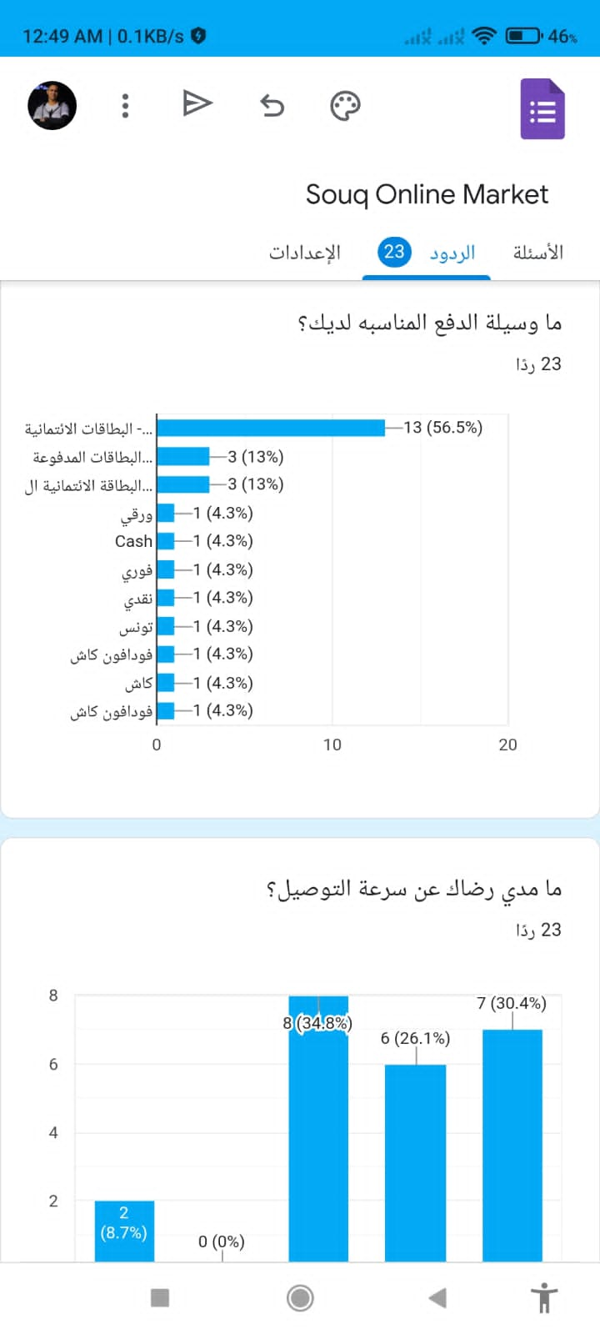
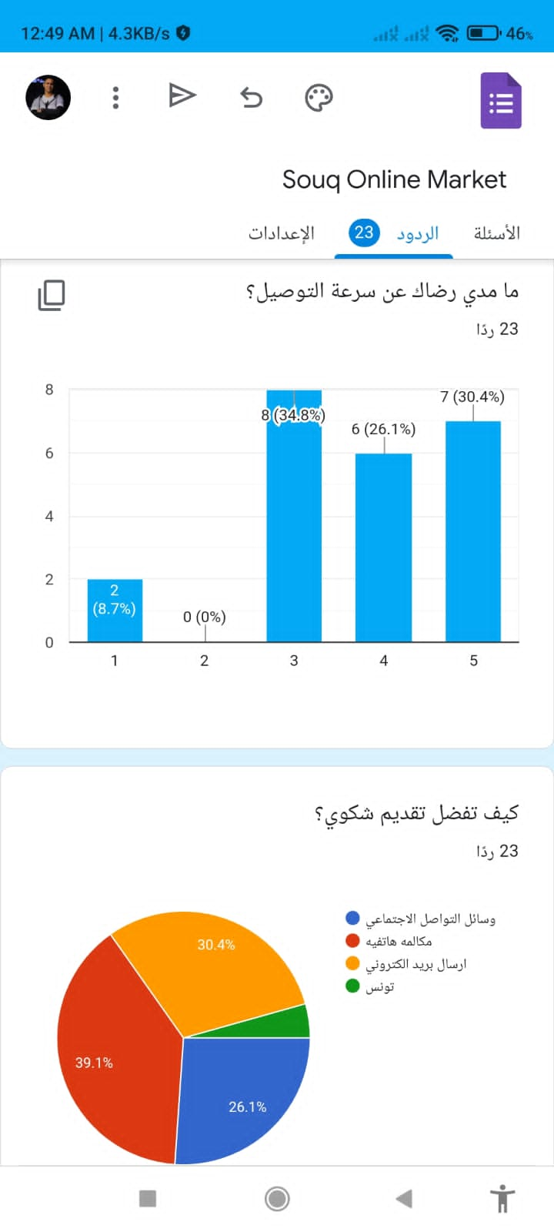

Slide 26
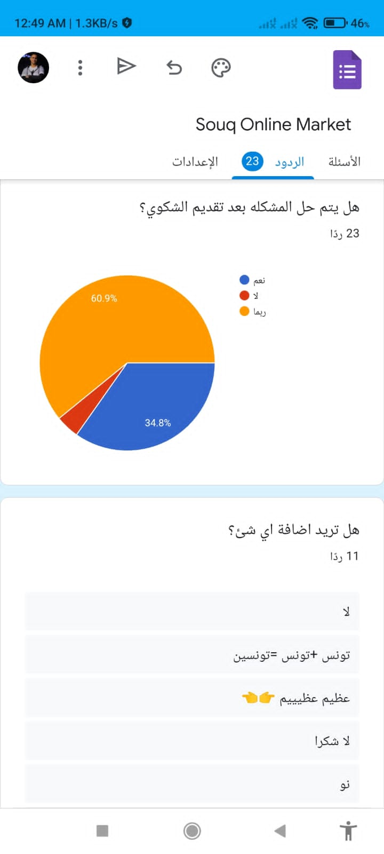
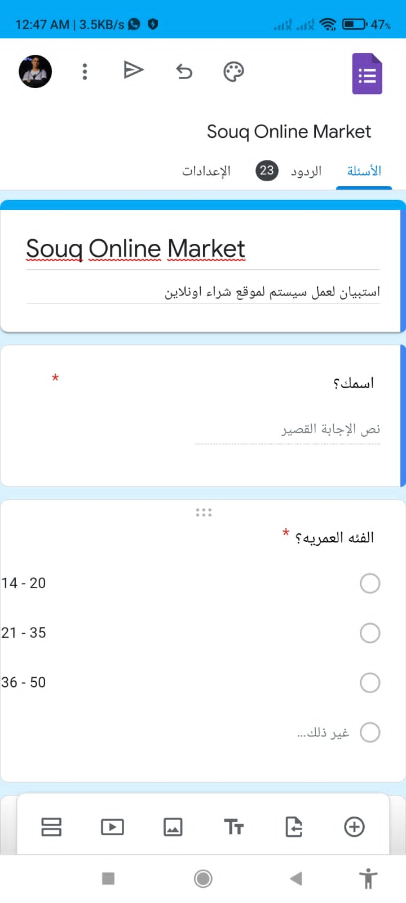
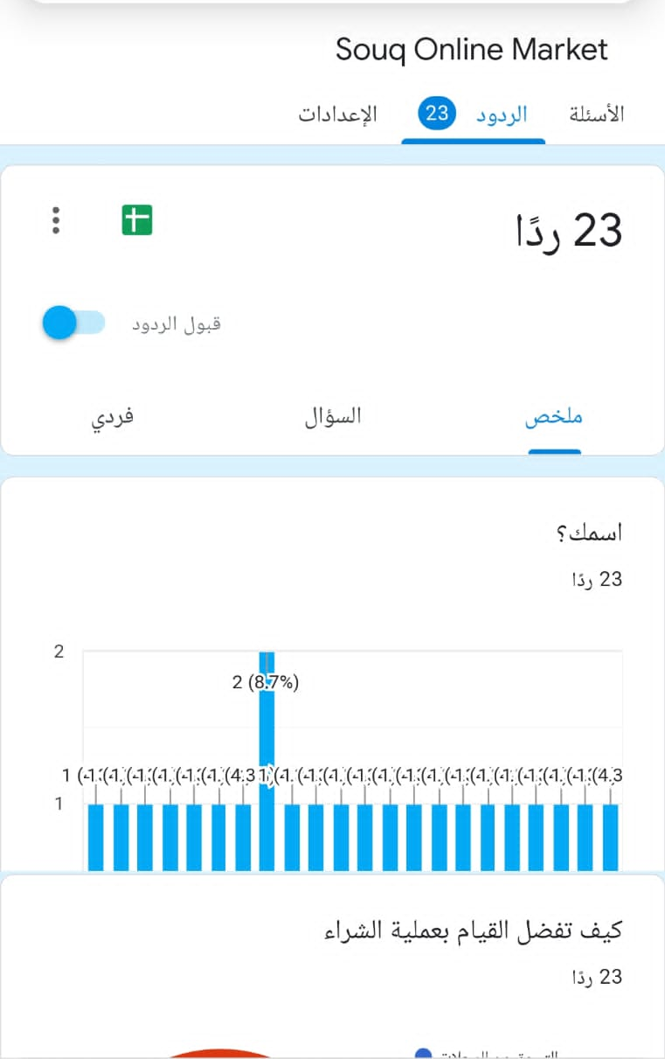

Slide 27
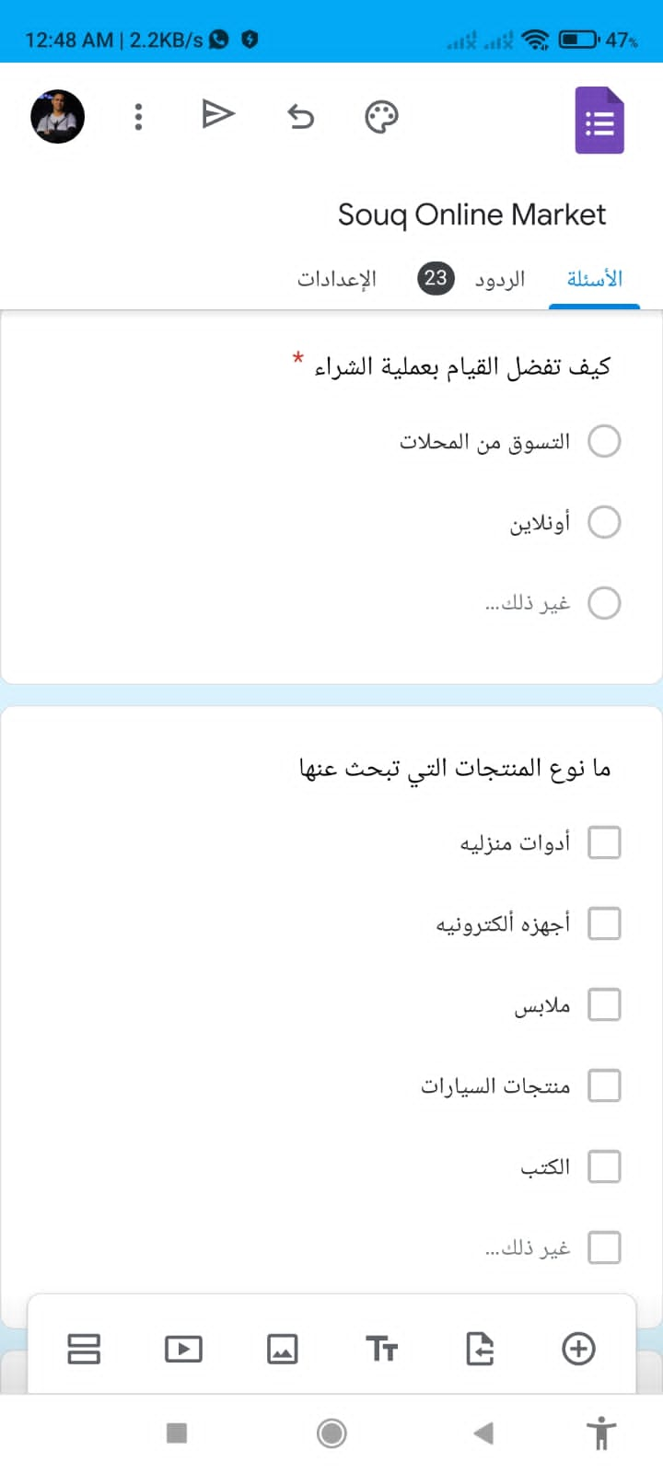
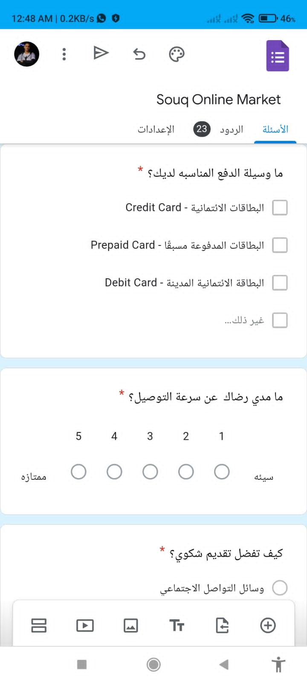
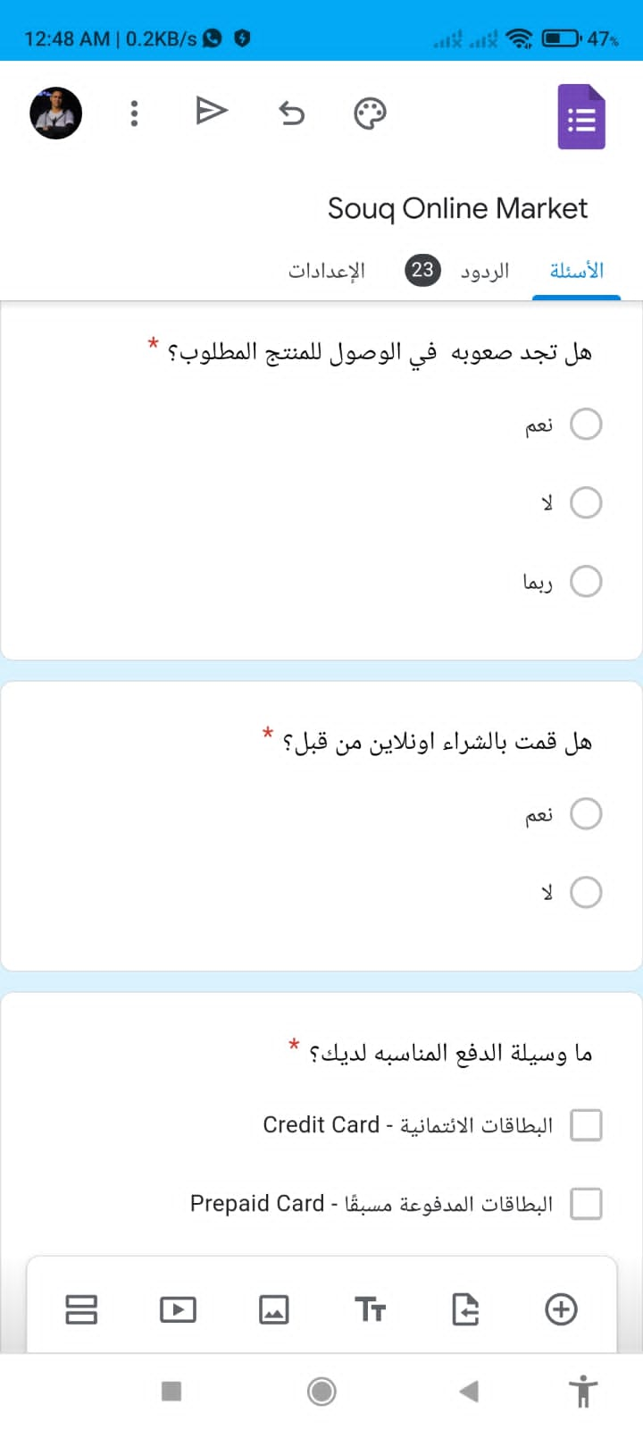

Slide 28
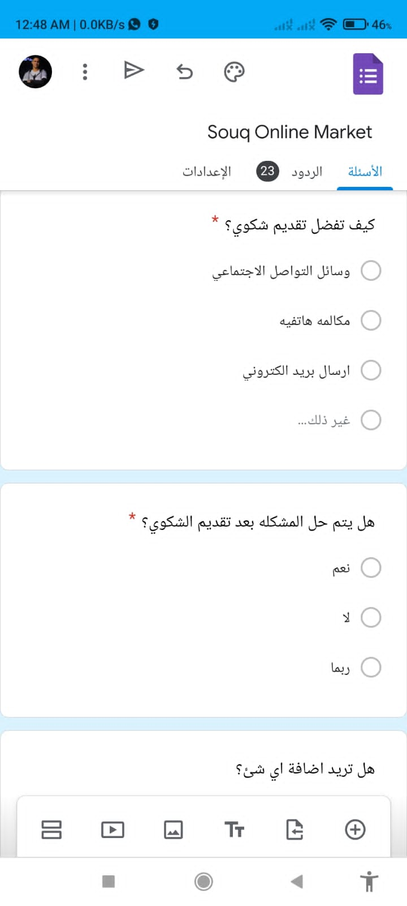
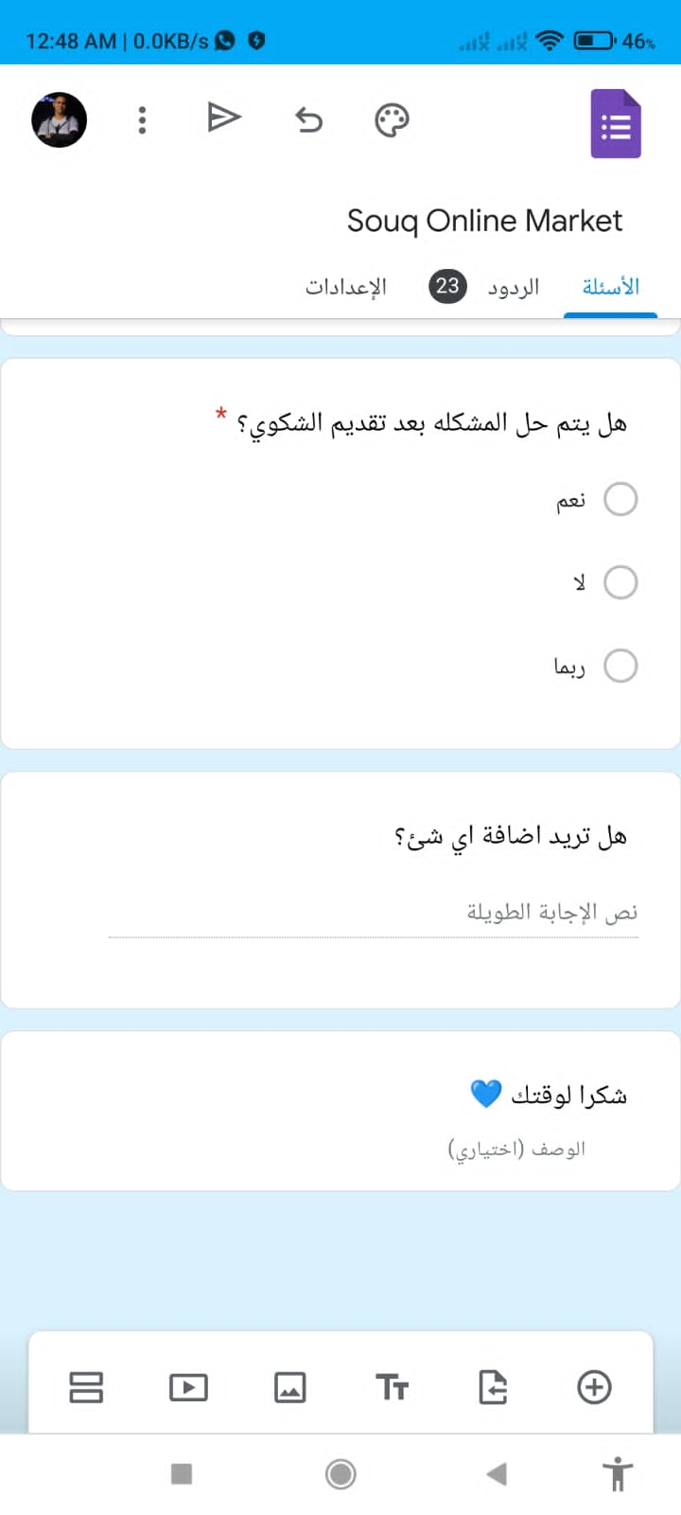

Slide 29
DFD :
Product Status& details
0
Online
System
Shopping
Set Order
Send Order List
}
Customer
Order Confirmation
Order details
Seller
Order Status
Payment& Delivery info
Level 1
1
Managing
Order
Information
Set Order
Send Order List
Order Confirmation
Order Details
Seller
Set Order
2
Confirmation
Order
}
Customer
Order confirmation
Order List
D1 Products Data Base
Order Status
3
Order
Status
Order Info
4
Order
Payment&
Delivery
Delivery& Payment details
Delivery& Payment details

Slide 30
Data Dictionary Data flow – Discription form

Slide 31

Data Flow
ID : 1 Name : Set order Description : Set order information the customer choose
Source : External Entity – Employee | Destination : Process 1 – Managing order informatoin
Type of data flow: file screen report form internal
Data Structure: Order Information | Volume / Time : 5 / hour
Comment: This information for one order

Slide 32
Data Flow
ID : 2 Name : order details Description : Send order information to the seller
Source : Process 1 – Managing order information | Destination : External Entity - Seller
Type of data flow: file screen report form internal
Data Structure: Order Information | Volume / Time : 5 / hour
Comment:

Slide 33
Data Flow
ID : 3 Name : send order list Description : Send order information to the cus
Source : External Entity - Seller | Destination : Process 1 – Managing order information
Type of data flow: file screen report form internal
Data Structure: Order Information | Volume / Time : 5 / hour
Comment:

Slide 34
Data Flow
ID : 4 Name : order confirmation Description : Confirm setting order from the customer
Source : External Entity – Customer | Destination : Process 1 – Managing order information
Type of data flow: file screen report form internal
Data Structure: Data Base Data | Volume / Time : 5 / hour
Comment:

Slide 35
Data Flow
ID : 5 Name : Order list Description : Send order information to the seller
Source : Data store D1 – Products Data Base | Destination : Process 1 – Managing order information
Type of data flow: file screen report form internal
Data Structure: Order Information | Volume / Time : 5 / hour
Comment:

Slide 36
Data Flow
ID : 6 Name : order info Description : Take order info from the data store to view order status
Source : Data Store D1 – Products data base | Destination : Process 3 – Order status
Type of data flow: file screen report form internal
Data Structure: Order Information | Volume / Time : 5 / hour
Comment:

Slide 37
Data Flow
ID : 7 Name : Order Status Description : view order status to the customer
Source : Process 3 – Order Status | Destination : External Entity – Customer
Type of data flow: file screen report form internal
Data Structure: Order Information | Volume / Time : 5 / hour
Comment:

Slide 38
Data Flow
ID : 8 Name : Delivery & Payment Details Description : Take payment details from the database to process 4
Source : Data Store D1 – Product data base | Destination : Process 4 – Order payment & Delivery
Type of data flow: file screen report form internal
Data Structure: Payment Information | Volume / Time : 5 / hour
Comment:

Slide 39
ID : 8 Name : Delivery & Payment Details Description : view the delivery & payment details to the customer
Source : Process 4 – Order payment & Delivery | Destination : External Entity - Customer
Type of data flow: file screen report form internal
Data Structure: Delivery&Payment Information | Volume / Time : 5 / hour
Comment:

Slide 40
Data Elements
Name | Customer Name
Alias | Customer Name
Description | Indicate the customer name
Length | 50
Input Format | Char
Output Format | Char
Default Value | Null
Continues / Discrete | Discrete
Type | Alphabetic
Base / Derived | Base
Upper Limit
Lower Limit
Discrete Values
Comments

Slide 41
Name | Customer Address
Alias | Customer Address
Description | Indicate the customer adress
Length | 70
Input Format | Char
Output Format | Char
Default Value | Null
Continues / Discrete | Discrete
Type | Alphabetic
Base / Derived | Base
Upper Limit
Lower Limit
Discrete Values
Comments

Slide 42
Name | Customer Purshases
Alias | Customer Purshases
Description | Indicate the customer Purshases
Length | 50
Input Format | string
Output Format | string
Default Value | Null
Continues / Discrete | Continues
Type
Base / Derived | Derived
Upper Limit | infinity
Lower Limit | 0
Discrete Values
Comments

Slide 43
Name | Payment Method
Alias | Customer Payment process
Description | Indicate the customer Payment method
Length | 50
Input Format | Number
Output Format | Number
Default Value | Null
Continues / Discrete | Continues
Type | Numeric
Base / Derived | Base
Upper Limit | infinity
Lower Limit | 0$
Discrete Values
Comments

Slide 44
Name | Order Name
Alias | Order Name
Description | Indicate the Order name
Length | 50
Input Format | Char
Output Format | Char
Default Value | Null
Continues / Discrete | Discrete
Type | Alphabetic
Base / Derived | Base
Upper Limit
Lower Limit
Discrete Values
Comments

Slide 45
Name | Order Information
Alias | Order Information
Description | Indicate the order information
Length | 150
Input Format | Char
Output Format | Char
Default Value | Null
Continues / Discrete | Continues
Type | Alphabetic
Base / Derived | Base
Upper Limit
Lower Limit
Discrete Values
Comments

Slide 46
Name | Order Price
Alias | Order Price
Description | Indicate the Order price
Length | 6
Input Format | int
Output Format | int
Default Value | Null
Continues / Discrete | Discrete
Type | Numeric
Base / Derived | Base
Upper Limit | 100000$
Lower Limit | 0.99$
Discrete Values
Comments

Slide 47
Name | Delivery Method
Alias | Delivery option
Description | Indicate the delivery way
Length | 50
Input Format
Output Format | char
Default Value | Null
Continues / Discrete | Continues
Type | Alphabetic
Base / Derived | Base
Upper Limit
Discrete Values
Comments

Slide 48
Data store:
Data store: (1) Description form
File Type: Computer Manual
File Format: Database Indexed Sequential Direct
Record Size (Characters): 500 Number of records (Maximum): 10000 Number of records (Average): 8000 Growth per year (percent): 8%
Dataset name: Products Data structure: Products data Primary key: Customer ID Secondary key: Product ID
Comments: the file is updated as the customer receives his order
Data store Description form
ID: D1
Name: System database
Alias: System data
Description: Contains data about each product & customer and order

Slide 49
ERD :
C_phone
C_id
S_name
S_id
C_name
C_address
P_id
Customer
Cu_Se
S_phone
P_id
Seller
buy
has
has
Work with
Deliver by
Product
Distributor
P_name
Deliver
D_name
P_id
D_id
P_price
D_phone
C_id

Slide 50
Normalization
D_phone | D_name | D_id | S_phone | S_name | S_id | P_price | P_name | P_id | C_address | C_phone | C_name | C_id
01111000022 | Mohamed Samy | 14 | 01222909876 | Saif Khaled | S3 | 40$ | Boots | 0601 | Shebin | 01111000123 | Ahmed Ali | 002
01001119998 | Tareq Ahmed | 13 | 01111909877 | Ali Ahmed | A2 | 35$ | Sneakers | 0701 | Cairo | 01001213141 | Alaa Yousef | 003
01011002332 | Mohamed Ibrahim | 12 | 01012228911 | Mohamed Ahmed | M1 | 20$ | Blouse | 0901 | Alex | 01222333444 | Heba Mohamed | 004
01001119998 | Tareq Ahmed | 13 | 01111909877 | Ali Ahmed | A2 | 35$ | Sneakers | 0701 | Alex | 01222333444 | Heba Mohamed | 004
01011002332 | Mohamed Ibrahim | 12 | 01011002332 | Mohamed Ahmed | M1 | 40$ | Bag | 0801 | Tanta | 01233009876 | Shahd Hossam | 005
01220022299 | Hady Samir | 15 | 01555112330 | Amal Ahmed | A4 | 50$ | Dresses | 0501 | Tanta | 01233009876 | Shahd Hossam | 005
01220022299 | Hady Samir | 15 | 01555112330 | Amal Ahmed | A4 | 100$ | Jacket | 0401 | Quwesna | 01155338899 | John Deo | 006
01220022299 | Hady Samir | 15 | 01555112330 | Amal Ahmed | A4 | 100$ | Jacket | 0401 | Banha | 01220001110 | Amr Ahmed | 007
01001119998 | Tareq Ahmed | 13 | 01111909877 | Ali Ahmed | A2 | 35$ | Sneakers | 0701 | Banha | 01220001110 | Amr Ahmed | 007

Slide 51
1NF
C_address | C_phone | C_name | C_id
Shebin | 01111000123 | Ahmed | 002
Cairo | 01001213141 | Alaa Yousef | 003
Alex | 01222333444 | Heba Mohamed | 004
Tanta | 01233009876 | Shahd Hossam | 005
Quwesna | 01155338899 | John Deo | 006
Banha | 01220001110 | Amr Ahmed | 007
D_phone | D_name | D_id | S_phone | S_name | S_id | P_price | P_name | P_id | C_id
01111000022 | Mohamed Samy | 14 | 01222909876 | Saif Khaled | S3 | 40$ | Boots | 0601 | 002
01001119998 | Tareq Ahmed | 13 | 01111909877 | Ali Ahmed | A2 | 35$ | Sneakers | 0701 | 003
01011002332 | Mohamed Ibrahim | 12 | 01012228911 | Mohamed Ahmed | M1 | 20$ | Blouse | 0901 | 004
01001119998 | Tareq Ahmed | 13 | 01111909877 | Ali Ahmed | A2 | 35$ | Sneakers | 0701 | 004
01011002332 | Mohamed Ibrahim | 12 | 01012228911 | Mohamed Ahmed | M1 | 40$ | Bag | 0801 | 005
01220022299 | Hady Samir | 15 | 01555112330 | Amal Ahmed | A4 | 50$ | Dresses | 0501 | 005
01220022299 | Hady Samir | 15 | 01555112330 | Amal Ahmed | A4 | 100$ | Jacket | 0401 | 006
01220022299 | Hady Samir | 15 | 01555112330 | Amal Ahmed | A4 | 100$ | Jacket | 0401 | 007
01001119998 | Tareq Ahmed | 13 | 01111909877 | Ali Ahmed | A2 | 35$ | Sneakers | 0701 | 007

Slide 52
2NF
P_price | P_name | P_id
40$ | Boots | 0601
35$ | Sneakers | 0701
20$ | Blouse | 0901
40$ | Bag | 0801
50$ | Dresses | 0501
100$ | Jacket | 0401
C_address | C_phone | C_name | C_id
Shebin | 01111000123 | Ahmed | 002
Cairo | 01001213141 | Alaa Yousef | 003
Alex | 01222333444 | Heba Mohamed | 004
Tanta | 01233009876 | Shahd Hossam | 005
Quwesna | 01155338899 | John Deo | 006
Banha | 01220001110 | Amr Ahmed | 007
S_id | P_id | C_id
S3 | 0601 | 002
A2 | 0701 | 003
M1 | 0901 | 004
A2 | 0701 | 004
M1 | 0801 | 005
A4 | 0501 | 005
A4 | 0401 | 006
A4 | 0401 | 007
A2 | 0701 | 007
D_phone | D_name | D_id | S_phone | S_name | S_id
01111000022 | Mohamed Samy | 14 | 01222909876 | Saif Khaled | S3
01001119998 | Tareq Ahmed | 13 | 01111909877 | Ali Ahmed | A2
01011002332 | Mohamed Ibrahim | 12 | 01012228911 | Mohamed Ahmed | M1
01011002332 | Mohamed Ibrahim | 12 | 01012228911 | Mohamed Ahmed | M1
01220022299 | Hady Samir | 15 | 01555112330 | Amal Ahmed | A4
01220022299 | Hady Samir | 15 | 01555112330 | Amal Ahmed | A4

Slide 53
3NF
S_id | P_id | C_id
S3 | 0601 | 002
A2 | 0701 | 003
M1 | 0901 | 004
A2 | 0701 | 004
M1 | 0801 | 005
A4 | 0501 | 005
A4 | 0401 | 006
A4 | 0401 | 007
A2 | 0701 | 007
C_address | C_phone | C_name | C_id
Shebin | 01111000123 | Ahmed | 002
Cairo | 01001213141 | Alaa Yousef | 003
Alex | 01222333444 | Heba Mohamed | 004
Tanta | 01233009876 | Shahd Hossam | 005
Quwesna | 01155338899 | John Deo | 006
Banha | 01220001110 | Amr Ahmed | 007
P_price | P_name | P_id
40$ | Boots | 0601
35$ | Sneakers | 0701
20$ | Blouse | 0901
40$ | Bag | 0801
50$ | Dresses | 0501
100$ | Jacket | 0401
S_name | S_id
Saif Khaled | S3
Ali Ahmed | A2
Mohamed Ahmed | M1
Mohamed Ahmed | M1
Amal Ahmed | A4
Amal Ahmed | A4
D_phone | D_name | D_id | S_phone | S_name
01111000022 | Mohamed Samy | 14 | 01222909876 | Saif Khaled
01001119998 | Tareq Ahmed | 13 | 01111909877 | Ali Ahmed
01011002332 | Mohamed Ibrahim | 12 | 01012228911 | Mohamed Ahmed
01220022299 | Hady Samir | 15 | 01555112330 | Amal Ahmed

Slide 54
1 - Operational Requirments
Type of Requirement
Technical Environment | 1.1 – The system will work over web environment with any web browser. 1.2 – The customer will just need an internet service and install any web browser on his device.
System Integration | 1.3 – The internet system will read order information from the database (price – amount – discount … etc). 1.4 – The internet system will just read the order information it will not change . 1.5 – The internet system will read and write the customer information.
Portability | 1.6 – We use a good web host services and reliable domain.
Maintainability | 1.7 – There will be annual maintenance. 1.8 – There will be urgent maintenance in case the system malfunction.

Slide 55
2 – performance Requirments
Type of requirment
Speed | 2.1 – Response time will be less than 5 seconds. 2.2 – Website will be fast and secure to complete shopping efficiently.
Capacity | 2.3 – There will be a maximum of 500 user at peak use time. 2.4 – There will be another sever in case any problem happen.
Availability and reliability | 2.5 – The system will be available anytime(24 / 7) 2.6 – The system shall work efficiently (99%) up time performance.

Slide 56
3 – Security Recuirments
Types of requirements
System Value | 3.1 – There will be a great value of the system, as it make it easy to buy things you need.
Access Control | 3.2 – The customer can access to his account with e-mail and password.
Encryption / Authentication | 3.4 – Customer payment information are secured and no body can access to it.
Virus Control | 3.4 – There will be best protection to protect the website and the customer will have no trouble with viruses.

Slide 57
4 – Cultural and Political Requirements
Type of requirement
Multilangual | 4.1 – The system will be operate in English as a main language and Arabic as a second language.
Customization | 4.2 – There will be managers from the region to check customers need in this region and add their needs to the system. 4.3 – Country managers will have access to change means of communication in the region to be suitable with the customer.
Making Unstated Norms Explicit | 4.4 – All data fields will be explicitly identified as using the month - day - year format.
Legal | 4.5 – The system is suitable with middle-east laws and requirements and there is no illegal process happens. 4.6 – All customers data are secured and taxes will be paid regularly.

Slide 58
Use scenario development :
Use scenario: The Browsing Shopper user is not sure what they want to buy and will browse through several products.
1)User may search for a best seller products through a products category(1.2). 2) User will likely read the basic information for several products as well as marketing material for some and search for today deals(1.3). 3)User will put the product in the shopping cart(1.3)and will continue browsing(1.2). 4) Eventually, the user want to purchase the product but will probably want to look through the shopping cart , possibly discarding some products.
Use scenario: the hurry-up shopper user knows exactly what he or she wants and wants it quickly.
1)User will search for a specific product. (1.2). 2) User will read enough information about product . 3)User will look at about the price . 4)User will look at about today deals. 5)User will want to buy a product or move on to other web.

Slide 59
0
main menu(system home page)
2) Interface structure design (ISD) :
1
Search for product
1.2
2
Browse by Genre
2.1
3
web promotion
1.1
1.1
Search by product name
1.2
2
List by Genre
1.2
3.1
List most popular products
1.1
1.2
Search by best seller
1.2
4
Show info for one product
1.3
3.2
List new products
1.1
1.3
Search by Today's Deals
1.2
3.3
list web specials
1.1
4.4
Add to shopping cart
1.3
1.4
view favorites
1.2
4.1
Show liner notes
1.3
4.2
Show sample
1.3
4.3
Add to favorites
1.3

Slide 60
3) Interface standards design :
Interface metaphor : souq.com
Interface objects
- Product : all items Electronic devices, household appliances, clothes, etc.
- Title : the title of product.
- best seller : best selling products.
- Today's Deals : Products with discounts and offers.
- Shopping cart : a place to store products until they are purchased.
- favorites : a place for the customer to store product of interest.
Interface Action
- Search for : display a products list matches specified criteria.
- Browse : display a products list sorted in order by some criteria.
- Buy : permission to buy the product.
Interface icons
- souq.com icon will be used on all screens.

Slide 61
4) Interface design prototyping: storyboards
Product Menu :
Add product
Find product
List products
Add a new product:
Name
Brand
Price
Serial number
Find a product:
(type in information to search)
Name
Brand
Price
Serial number
Product information:
Name Jacket
Brand Zara
Price 3000
Serial number 1111001
Product list:
(click on a product for more information)
Blouse, Bag, Sneakers, Boots, Dresses,
Jacket

Slide 62

HTML prototyping :
Souq.com
View your favorite
Search text
search
Home
About souq.com
Contact us
Buy now
Today deals
Best seller
Categories :
Quick links:
Welcome to Souq.com
Here is everything you can think of, just register with us
New deals :
Sign in
register

